Slide 1
A game is:
An adversarial search problem
A interactive decision problem where
The solution is not built exclusively by a single strategy
Not all final states are desirable
A Game always has:
A starting state (the game instance)
At least one state which determines the end of the game if reached
At least one goal for each player (not necessarily an end state)
Rules for each player (not always the same)
At least two sources determining changes to the current state
Zero sum games:
Something won by a player is lost by the other(s).
Also called strictly competitive games.
Many games are not zero-sum!
Non zero-sum game:
I have n money and I want to give it to a group of m players. Each of the m players has to write a sum on a piece of paper visible only to them. I collect all pieces of paper and total the sums. If the total is at most as much as n, each player gets the written amount, otherwise nobody gets anything.

Slide 2
Single player games:
One active player - one controlling strategy
At least one additional source of information
Cannot be zero-sum games
Multiple player games:
Can have different rules and goals for all players.
Symmetrical games: all rules and goals are the same for all players.
Other types of games:
If the state change is determined by multiple player decisions at the same time, the game is simultaneous.
If the state change is determined in alternative turns by each player, the game has alternate moves.
If each player knows everything about the current state of the game, all previous decisions made by all players and all rules and goals of all players, the game has perfect information.
Imperfect information games: card games

Slide 3
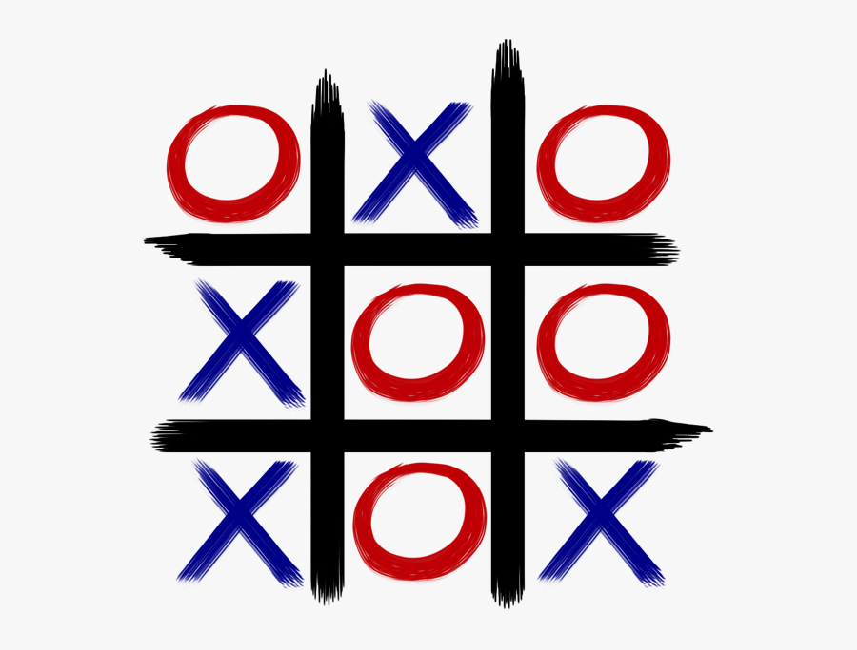
Describing a state of Tic-Tac-Toe game:
(p, b₁₁, b₁₂, b₁₃, b₂₁, b₂₂, b₂₃, b₃₁, b₃₂, b₃₃)
p𝞊{1,2}, 1 if we are next to move, 2 if the opponent;
b_{ij}𝞊{0,1,2}, 0 if the b_{ij} position is empty, 1 if it’s occupied by one of our pieces and 2 if it’s one of the opponents.
is (1, 2, 1, 2, 2, 2, 1, 1, 2, 1)
Game initialisation
State initialisation (int first_player)
{
return (first_player, 0, 0, 0, 0, 0, 0, 0, 0, 0) ;
}

Slide 4
Transition and validation:
State move (State S, int position)
{
S[position]=S[0]; S[0]=3-S[0]; return S;
}
Boolean Validate (State S, int position)
{
return (S[position]==0);
}
Void strategy(State s)
{
While (!isFinal(s))
{
If it’s my turn
Choose position;
If (Validate (s, position))
s = Transition(s, position);
Else get other player(s) decisions and change s
}
}

Slide 5
The MINIMAX strategy
Select a depth for exploration, at the minimum it has to include a full step for all other players.
Select a score function (heuristic) which evaluates a state as to its value for the other player(s). The better the score, the less desirable that state is from your perspective. The opponent should either be the maximising player (higher score is better) or minimising player (lower score is better).
score minimax(depth, state, next_player)
{
if(final(state)||(depth==0))
return score(state);
else if (next_player is the minimising one)
return min(minimax(depth-1,each neighbour state,next_player);
else
return max(minimax(depth-1,each neighbour state,next_player);
MINIMAX considerations:
The objective of MINIMAX is to allow the opponent to make the worst possible moves, assuming it will always choose the best move available.
The depth of exploration is crucial to the MINIMAX accuracy.
The depth of exploration is limited by the necessity to store every explored state.
MINIMAX is predictable and assumes predictable opponents.

Slide 6
The MINIMAX strategy example
minimax(2, S, AI) = min (score (minimax (1, A, OP)), score (minimax (1, B, OP)),
score (minimax (1, C, OP))) = min (max (1, 5, 9), max (8), max (3, 9, 2)) = 8 (choice B)
S
A
B
C
1
5
9
8
3
9
2

Slide 7
The ALPHA-BETA optimisation
For each state up to (but not including) the selected depth, keep two values (alpha and beta), alpha being the minimum maximum up to that depth and beta being the maximum score up to that depth.
If for a state alpha is greater or equal than beta, stop exploring further accessible states.
Update alpha and beta scores each time a score is computed.
score alphabeta(depth, state, next_player, alpha, beta)
{
if(final(state)||(depth==0))
return score(state);
else for all neighbour states
if (next_player is minimising)
score = min(alphabeta (depth-1, each_child, next_player, alpha, beta); if (score <= alpha) return alpha;
if (score<beta) beta=score;
else
score = max(alphabeta (depth-1, each_child, next_player, alpha, beta); if (score >= beta) return beta;
if (score>alpha) alpha=score;
return score;
}

Slide 8
ALPHA-BETA example
ALPHA-BETA is sensitive to the order of evaluation of neighbours and can be further optimised by an order heuristic.
S
alpha=3
beta=9
alpha=9
beta=9
alpha=8
beta=3
A
alpha=9
beta=8
B
C
1
5
9
8
3
9
2

Slide 9
Prisoner’s dilemma
Average payoff for A, with non-cooperation.
If A chooses Deny: (-1+-3)/2 = -2 If A chooses Confess: (0+-2)/2=-1
Strategy: The decisions made by a player for all possible states in which he has to make a decision.
A strategy making the same choice everytime is called a pure strategy. For example, choosing “Deny” all the time is a pure strategy for player A.
A B | Deny | Confess
Deny | -1 -1 | -3 0
Confess | 0 -3 | -2 -2

Slide 10
Dominant strategy
A strategy is dominant if it always provides payoffs at least as good as any other strategy.
A strategy is strictly dominant is the payoffs are always better than any other strategy.
Is there a dominant strategy for Prisoner’s Dilemma? Yes, “Confess” is a strictly dominant strategy.
Pareto optimality
A strategy is Pareto optimal if no change can be made to it in order to improve the players’ payoff without diminishing the other players payoffs.
(Deny/Deny) is Pareto optimal, as well as (Deny/Confess) and (Confess/Deny). (Confess/Confess) is not optimal as if either player changes decision to improve outcome the outcome for the other player will decrease.
What about the game below?
(X/X) or (X/Y) or (Y/X) are not Paretto optimal, (Y/Y) is.
 | X | Y
X | 1 1 | 2 2
Y | 2 2 | 2 3

Slide 11
Nash Equilibrium
If in a game all players obey the game rules and aim to maximize their payoffs, there is at least one strategy for each player which guarantees maximum payoffs for each player.
That strategy is called Nash optimum or equilibrium.
No player has a reason to change an equilibrium as long as anybody follows one.
A dominant and Paretto optimal strategy is always an equilibrium. However, for most games no dominant strategies exist.
Equilibria work only if all players obey the game rules and aim to maximize their payoffs.
Minimax is an equilibria for all two player zero-sum game.

Slide 12
Hunting game
Are there any dominant strategies? NO
Are there any equilibria? YES: (Stag, Stag) and (Rabbit, Rabbit)
Equilibria are dependent on the other players behaving as expected!
 | Stag | Rabbit
Stag | 5 5 | 0 3
Rabbit | 3 0 | 4 4
Chicken game
The two equilibria (Straight, Turn) and (Turn, Straight) are very dependent on the opponent’s strategy, otherwise both players get worse results.
 | Straight | Turn
Straight | -3 -3 | 3 -2
Turn | -2 3 | -3 -3

Slide 13
The money game
I have n money and I want to give it to a group of m players. Each of the m players has to write a sum on a piece of paper visible only to them. I collect all pieces of paper and total the sums. If the total is at most as much as n, each player gets the written amount, otherwise nobody gets anything.
Is there any dominant strategy? NO
What is the equilibrium?
Each player writes n/m.
The Goalkeeper game
There is no pure strategy equilibria.
What is the actual equilibria?
Shooter Keeper | Left | Right
Left | -1 1 | 1 -1
Right | 1 -1 | -1 1

Slide 14
Parrondo's paradox
There is at least one winning strategy which can be built using two losing strategies alternatively.
Game: add or substract money. Game ends if sum at or below zero.
S1: If you have an even sum, add 3. Otherwise substract 5.
S2: If you have an odd sum, substract 1.
S1,S2,S1,S2,... is dominant for both S1 and S2.
Mixed strategies
Strategies which are not pure are called mixed.
For most games, pure strategies are not equilibria.
Mixed strategies are usually non-deterministic, making some random decisions (stochastic or probabilistic).
How can we compute the equilibria for the goalkeeper game?

Slide 15
Computing equilibria as a mixed strategy
The equilibria (EQS and EQK) must provide equal payoffs for all possible opponent decisions.
EQS(Left) payoff is -1*EQK(Left)+1*EQK(Right)
EQS(Right) payoff is 1*EQK(Left)-1*EQK(Right)
Equal payoff means that -1*EQK(Left)+1*EQK(Right)=1*EQK(Left)-1*EQK(Right)
So EQK(Left)=EQK(Right)=0.5 since EQK(Right)+EQK(Left)=1. Equilibria is reached when both choices are as probable.
Shooter Keeper | Left | Right
Left | -1 1 | 1 -1
Right | 1 -1 | -1 1

Slide 16
Overall considerations about strategies
Strategies should have to have a way of estimating the missing information (eg. other player’s decisions)
Strategies have to be unpredictable: many use either random steps or select randomly between two or more strategies
You can prove that some strategies are better than others
If a there is a strategy better than all others then it’s not a game, it’s a puzzle
An useful benchmark strategy is the equilibria which exists and can be determined for all games
Monte-Carlo strategies
Generate all neighbours of the current state and add them to the graph until a set depth has been reached OR until enough final states have been reached
Run a simulation for all unexplored states in the graph
Until n final states are reached OR
Up to depth m
Compute a score for each state after each simulation (for example (positive-negative)/n))
Update the scores of all nodes above the current one using the newly computed score
Return to the first step
Select the neighbour of the starting state with the best score

